Slide 1

COMPARING SEVERAL METHODS OF REINFORCEMENT LEARNING IN SOLVING A COMPLEX MAZE
Li Meng S2651513
Mega Bagus Herlambang P279285
Yuying Chen S3421902
Zhuoyun Kan S3346935

Slide 2
What is reinforcement learning?
“In reinforcement learning, the learner is a decision-making agent that takes actions in an environment and receives reward (or penalty) for its actions in trying to solve a problem.” (Alpaydin, 2014, p. 517)

Slide 3
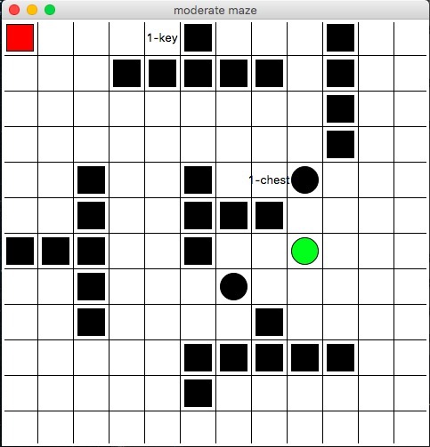
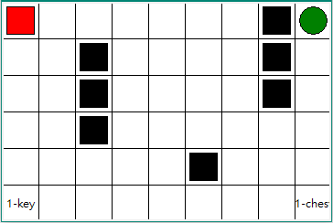
The maze
To compare performances with different algorithms, different kinds of mazes are designed
Elements in the maze:
Walls
Pits
Pairwise keys -> chests
Exit

Slide 4
Goal & rules
Add a maze here:
Get maximal rewards in shortest path
Find the key -> open the chest -> exit ☺
Can not go through the fixed walls
Have punishment when stepping into the pits ☹

Slide 5
algorithms
1. Basic algorithms:
2. Algorithms with lambda:
Q-learning
Sarsa
Q-lambda
Sarsa-lambda
QV-lambda
Indicators
Maximal rewards to obtian
Steps to solve the maze

Slide 6
Q-LEARNING & Sarsa
Add Q plot here
Add Sarsa plot here
We can see the difference between the two alogrithms:
………

Slide 7
Algorithms With LAMBDA
1. Lambda = 0
Three plots:..
2. Lambda = 0.5
Three plots:…
3. Lambda = 0.8
Three plots:….

Slide 8
To get optimal convergence
Dynamic greedy:
The greedy increases depending on time in training phase
Rewards and punishments of different elements
key = 0, chest = 500, exit = 500
When two rewards compete :
new coefficient: x-p/p(1-p)
……….

Slide 9
conclusion
...life is hard ☺

